Slide 1
LINE Beacon Proposal
API Type 提供資訊

Slide 2
[Notice] Information Security Compliance
Service MUST follow the LINE's terms of use:
LINE Beacon Terms and Conditions: https://terms.line.me/line_SpecificTerms_LINEBeacon?lang=en
LINE Developers Agreement: http://terms2.line.me/LINE_Developers_Agreement
LINE Data Policy: https://terms2.line.me/LINE_Developers_user_data_policy

Slide 3
UI Flow
請在下頁說明如何利用LINE官方帳號與API將服務或應用程式與LINE Platform串接，
以了解LINE官方帳號上要呈現什麼內容，以及用戶的操作流程。

Slide 4
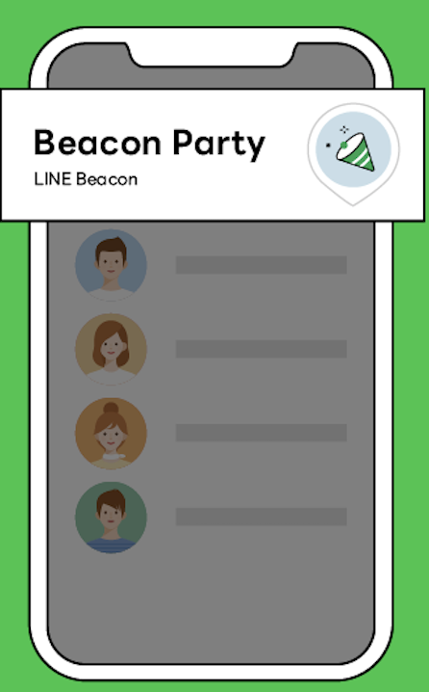
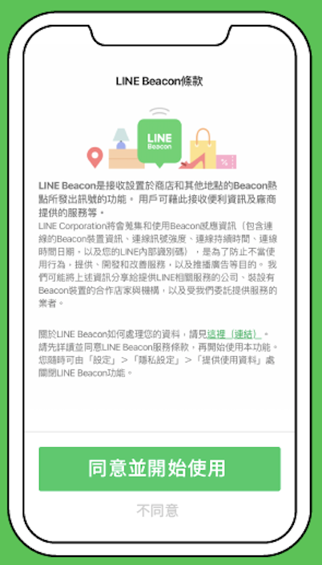
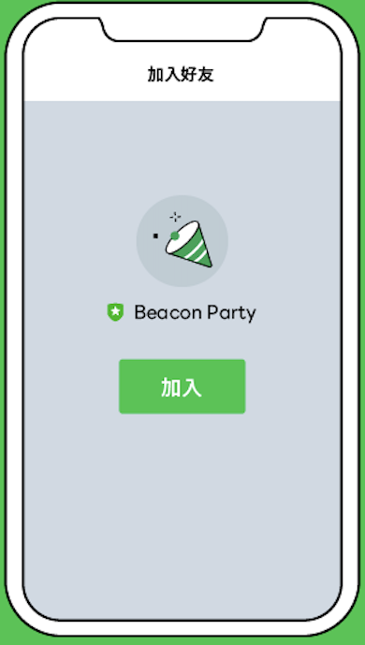
UI Flow
Beacon Banner | LINE Beacon Opt-in | Add Friend | Action
LINE 聊天列表上方顯示Banner | 按下Banner後顯示Beacon授權畫面 (僅第一次) | 確認Beacon授權後，顯示OA加好友授權 | 進入對話視窗後的動作或訊息
 |  |  | 請貼上訊息測試截圖，或是預計文案示意圖

Slide 5
綁定流程
請提供用戶使用LINE帳號與服務系統綁定流程
Please provide flow how you associate users’ LINE account with your service system if available.

Slide 6
Data Overview

Slide 7
Data Flow
請列出將收集或儲存的的用戶資訊
Please list down what kind of Personal User Data you will collect and store?
LINE User ID
Email

Slide 8
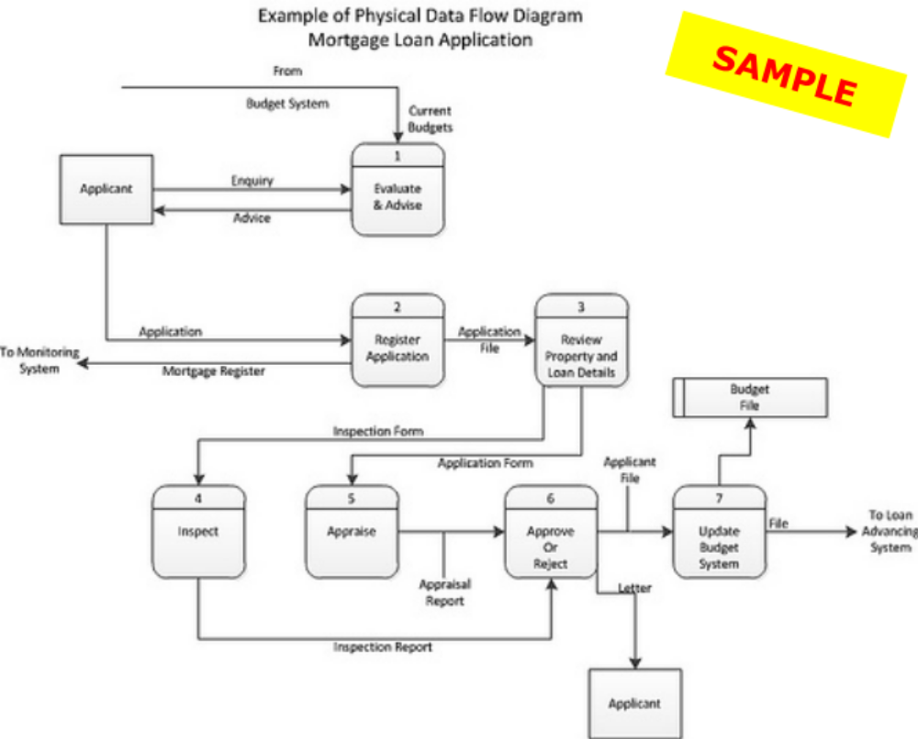
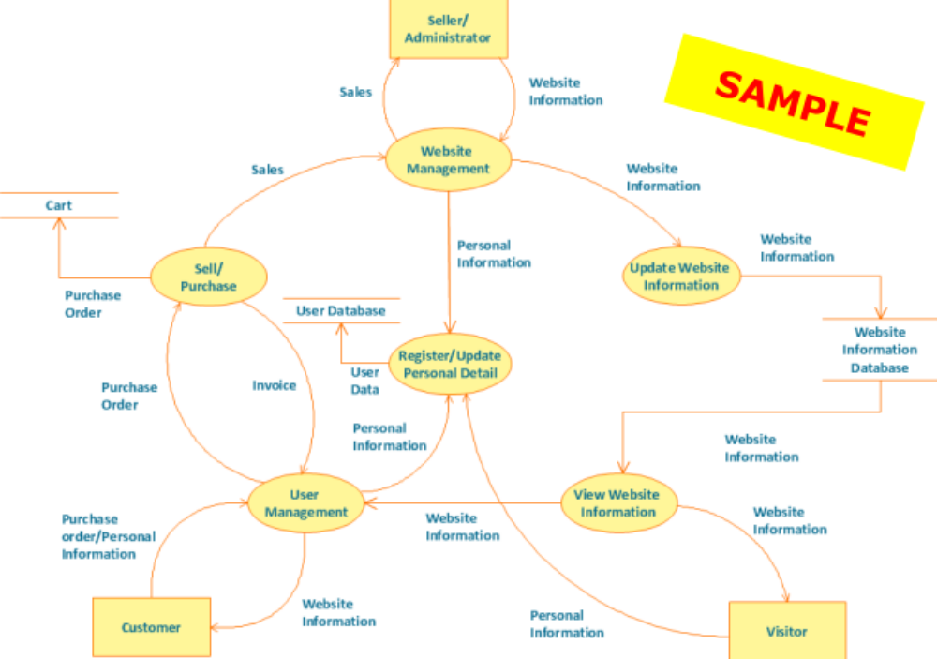
Data Flow
Data Flow Diagram

Slide 9
Data Flow of CRM
Please provide If applicable

